Slide 1

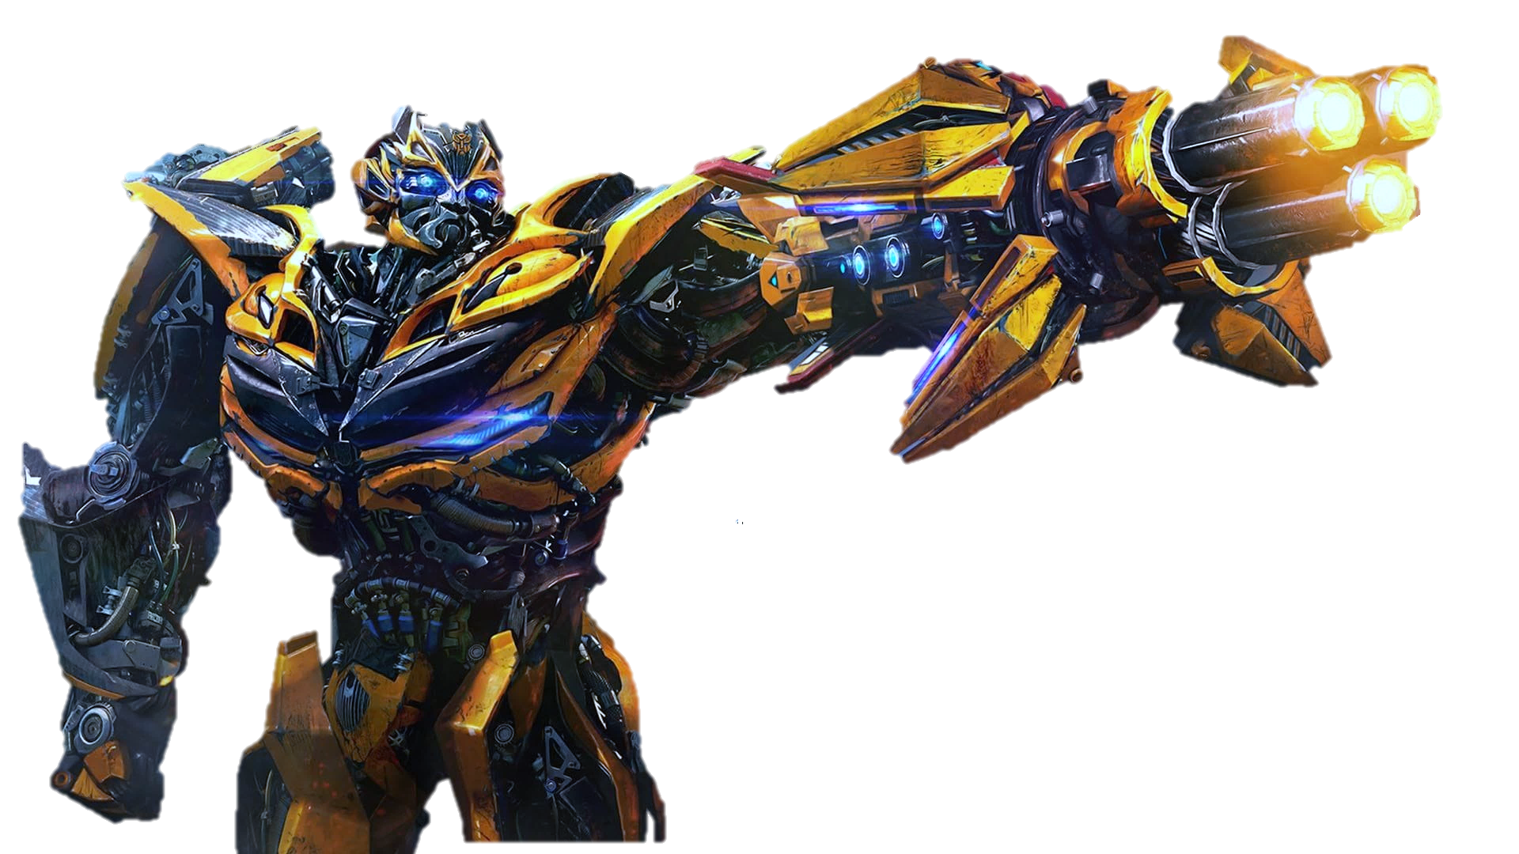
Transformer Neural Networks
In guidance of : Dr.Aminian
Sina Razaghi Kashani

Slide 2



1
🠺
🠺
TRANSFORMERS IDEA
RESULTS AND DISCUSSION
01
03
02
04
INTRODUCTION
TRANSFORMERS
ARCHITECTURE

Slide 3


1
2
🠺
🠺
TRANSFORMERS IDEA
RESULTS AND DISCUSSION
01
03
02
04
INTRODUCTION
TRANSFORMERS
ARCHITECTURE

Slide 4
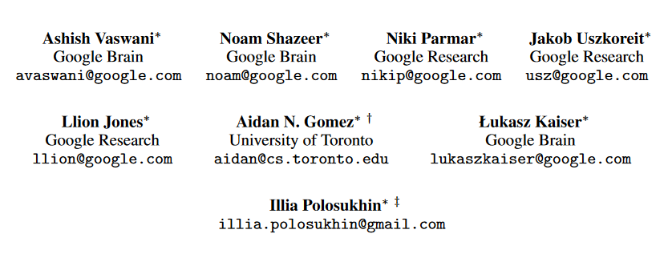
1
3
🠺
🠺

Slide 5
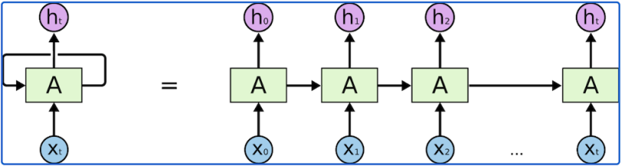
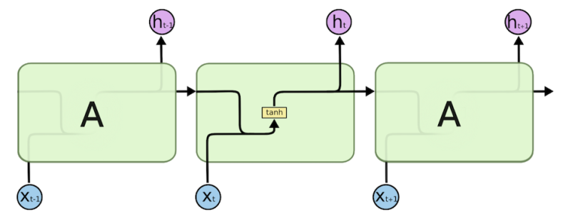
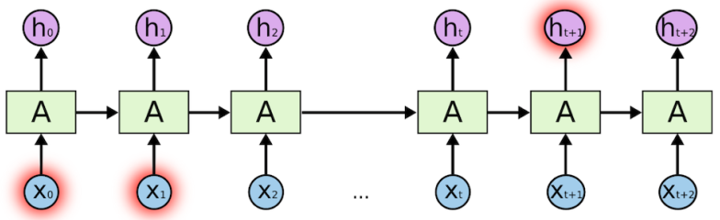
INTRODUCTION
1
4
🠺
RNN:
🠺
Vanishing Gradient
Slow Training
Long Sequences

Slide 6
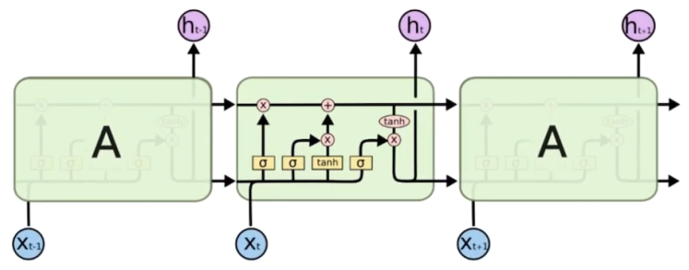
INTRODUCTION
1
5
🠺
LSTM:
🠺
Vanishing Gradient
Slow Training
Long Sequences 100
Long Sequences 1000

Slide 7
2
6
🠺
TRANSFORMERS IDEA
RESULTS AND DISCUSSION
01
03
02
04
INTRODUCTION
TRANSFORMERS
ARCHITECTURE

Slide 8
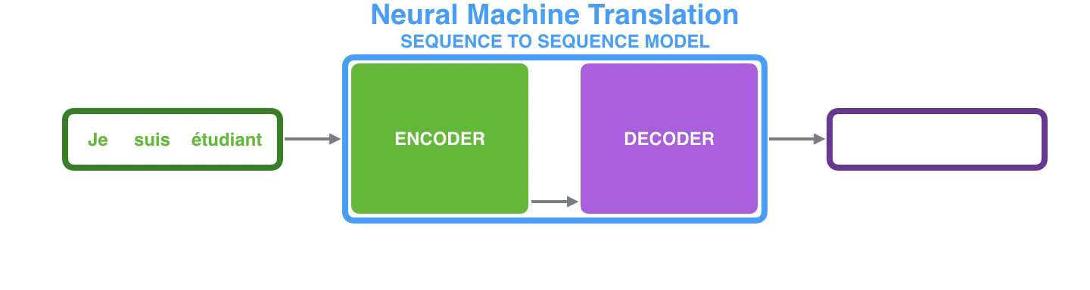
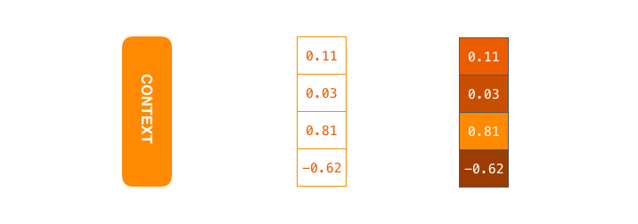
TRANSFORMERS IDEA (NMT)
2
7
NMT (neural machine translator) RNN simple seq-to-seq model
How works?
What is CONTEXT?
🠺
🠺

Slide 9
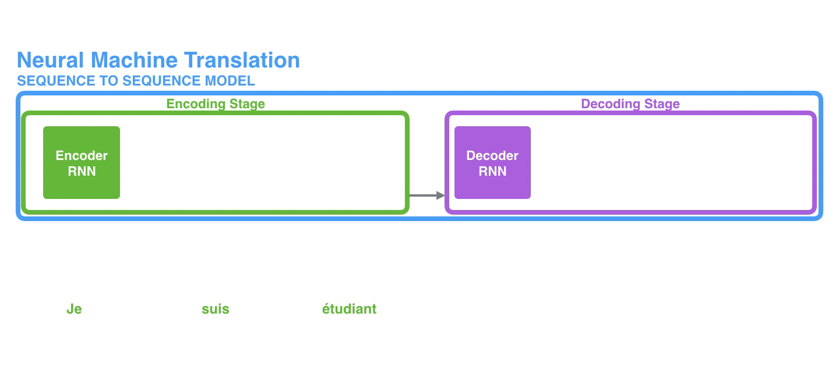
TRANSFORMERS IDEA (NMT)
2
8
NMT (neural machine translator) RNN simple seq-to-seq model
How works ?
What is CONTEXT ?
What is inside CONTEXT ?
🠺
🠺
Vanishing Gradient
Slow Training
Long Sequences
OUTPUT:
INPUT:

Slide 10

TRANSFORMERS IDEA
2
9
🠺
🠺
Attention is all you need

Slide 11

TRANSFORMERS IDEA
2
9
Like RNN
In 2017
but …
🠺
🠺

Slide 12
3
10
🠺
TRANSFORMERS IDEA
RESULTS AND DISCUSSION
01
03
02
04
INTRODUCTION
TRANSFORMERS
ARCHITECTURE

Slide 13
TRANSFORMERS ARCHITECTURE
3
11
First The input sequence can be passed in parallel …
🠺
🠺
[0.76 , 0.23 , 0.11 , 0.21 ]
[0.76 , 0.23 , 0.11 , 0.21 ]
[0.32 , 0.88 , 0.41 , 0.14 ]
[0.32 , 0.19 , 0.91 , 0.01 ]
[0.32 , 0.88 , 0.41 , 0.14 ]
[0.32 , 0.19 , 0.91 , 0.01 ]
RNN
(encoder)
Transformer
(encoder)
red
The
red
The
dog
dog

Slide 14
TRANSFORMERS ARCHITECTURE
3
12
🠺
🠺
Start with input

Slide 15

TRANSFORMERS ARCHITECTURE
3
13
Input Embedding …
🠺
🠺
Dog
[0.37 , 0.99 , 0.01 , 0.08 ]

Slide 16
TRANSFORMERS ARCHITECTURE
3
14
Input Embedding …
🠺
🠺
horse
“ Embedding Space ”
sun
Learns
dog
cat
red
Learns
human
happy
son
sad
love
guitar

Slide 17
TRANSFORMERS ARCHITECTURE
3
15
Input Embedding …
🠺
🠺
horse
sun
Learns
dog
cat
red
[0.37 , 0.99 , 0.01 , 0.08 ]
dog
human
happy
son
sad
love
guitar

Slide 18
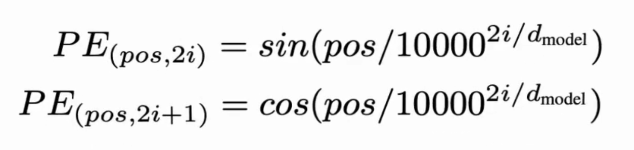
TRANSFORMERS ARCHITECTURE
3
16
Input Embedding …
🠺
🠺
“ Positional Encoder ”
AJ’s dog is a cutie.
Position 2
AJ looks like a dog.
Position 5

Slide 19
TRANSFORMERS ARCHITECTURE
3
17
Input Embedding …
🠺
🠺
[0.37 , 0.99 , 0.01 , 0.08 ]
Positional Encoder
[0.42 , 0.84 , 0.12 , 0.81 ]
Embedding of ‘dog’
Vector encoding of position in sentence
Embedding of ‘dog’
(With context info)

Slide 20
TRANSFORMERS ARCHITECTURE
3
18
🠺
🠺
Encoder Block
?

Slide 21
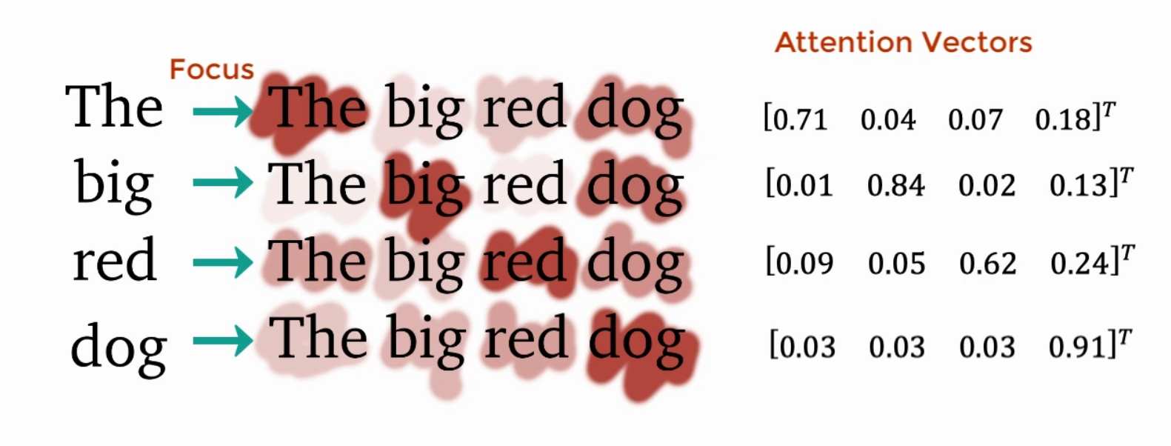
TRANSFORMERS ARCHITECTURE
3
19
First The input sequence can be passed in parallel …
Second is Encoder :
🠺
🠺
Attention (what part of input should we focus?) in multi-head attention.

Slide 22
TRANSFORMERS ARCHITECTURE
3
20
🠺
🠺
Encoder Block
?

Slide 23
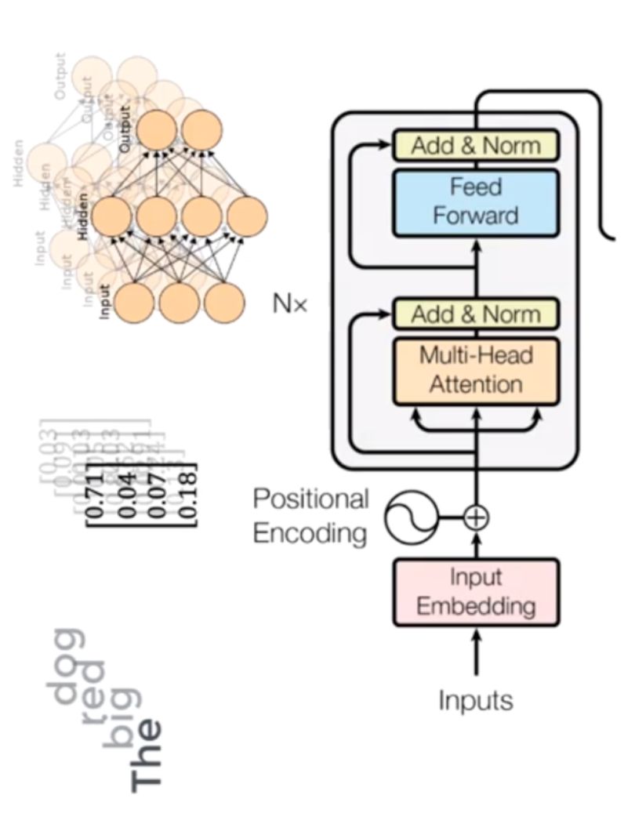
TRANSFORMERS ARCHITECTURE
3
21
First The input sequence can be passed in parallel …
Second is Encoder :
🠺
🠺
Attention (what part of input should w focus?) in multi-head attention
Feed-Forward Network

Slide 24
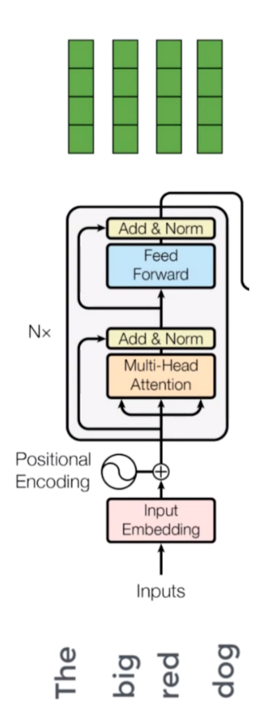
TRANSFORMERS ARCHITECTURE
3
22
First The input sequence can be passed in parallel …
Second is Encoder :
🠺
🠺
Attention (what part of input should w focus?) in multi-head attention
Feed-Forward Network: each of these attention vectors is independent of one another and So, we can apply parallelization here.

Slide 25
TRANSFORMERS ARCHITECTURE
3
23
First The input sequence can be passed in parallel …
Second is Encoder Block
Third is Decoder Block
🠺
🠺
Decoder Block
Encoder Block

Slide 26
TRANSFORMERS ARCHITECTURE
3
24
🠺
🠺
we’re training a translator for English to French.
“ The big red dog ”
“Le gros chien rouge ”

Slide 27
TRANSFORMERS ARCHITECTURE
3
25
🠺
🠺
Decoder Block
Encoder Block
?

Slide 28
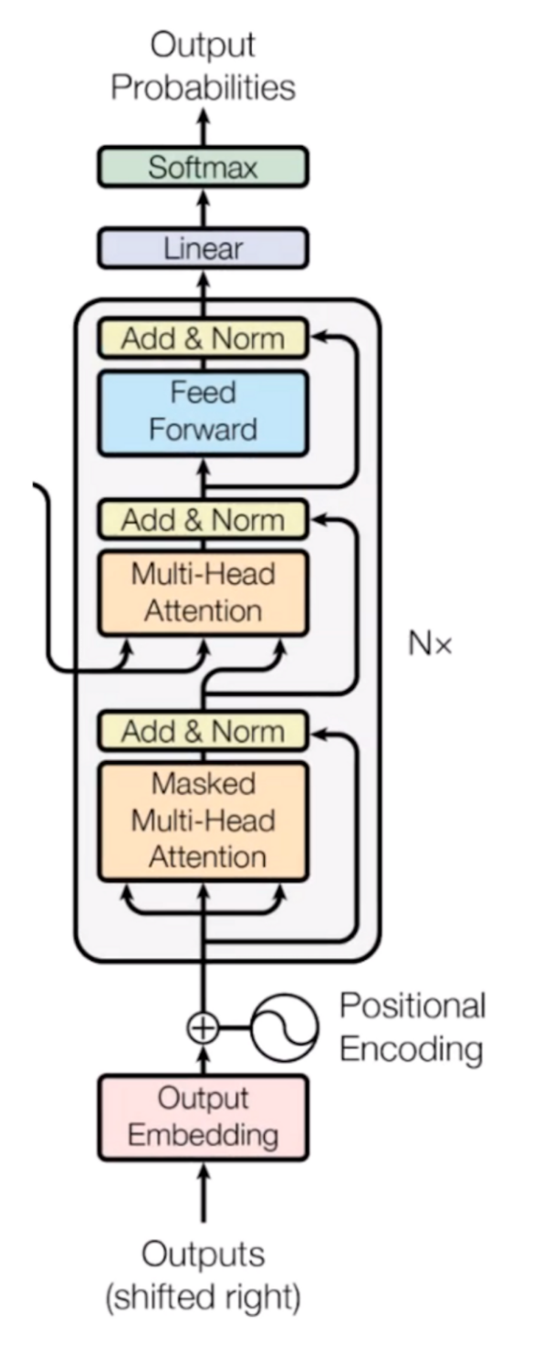
TRANSFORMERS ARCHITECTURE
3
26
First The input sequence can be passed in parallel …
Second is Encoder Block
Third is Decoder Block :
🠺
🠺
Embedding Vectors
Le
gros
chien
rouge

Slide 29
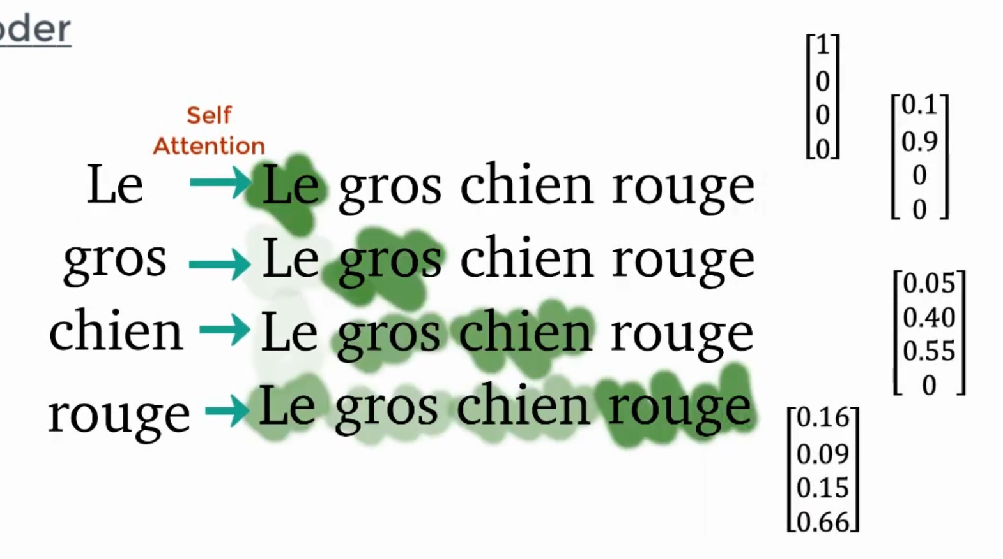
TRANSFORMERS ARCHITECTURE
3
27
First The input sequence can be passed in parallel …
Second is Encoder Block
Third is Decoder Block :
🠺
🠺
Embedding Vectors
Masked Multi-head attention

Slide 30
TRANSFORMERS ARCHITECTURE
3
28
First The input sequence can be passed in parallel …
Second is Encoder Block
Third is Decoder Block :
🠺
🠺
Embedding Vectors
Masked Multi-head attention
Le
gros
chien
rouge

Slide 31
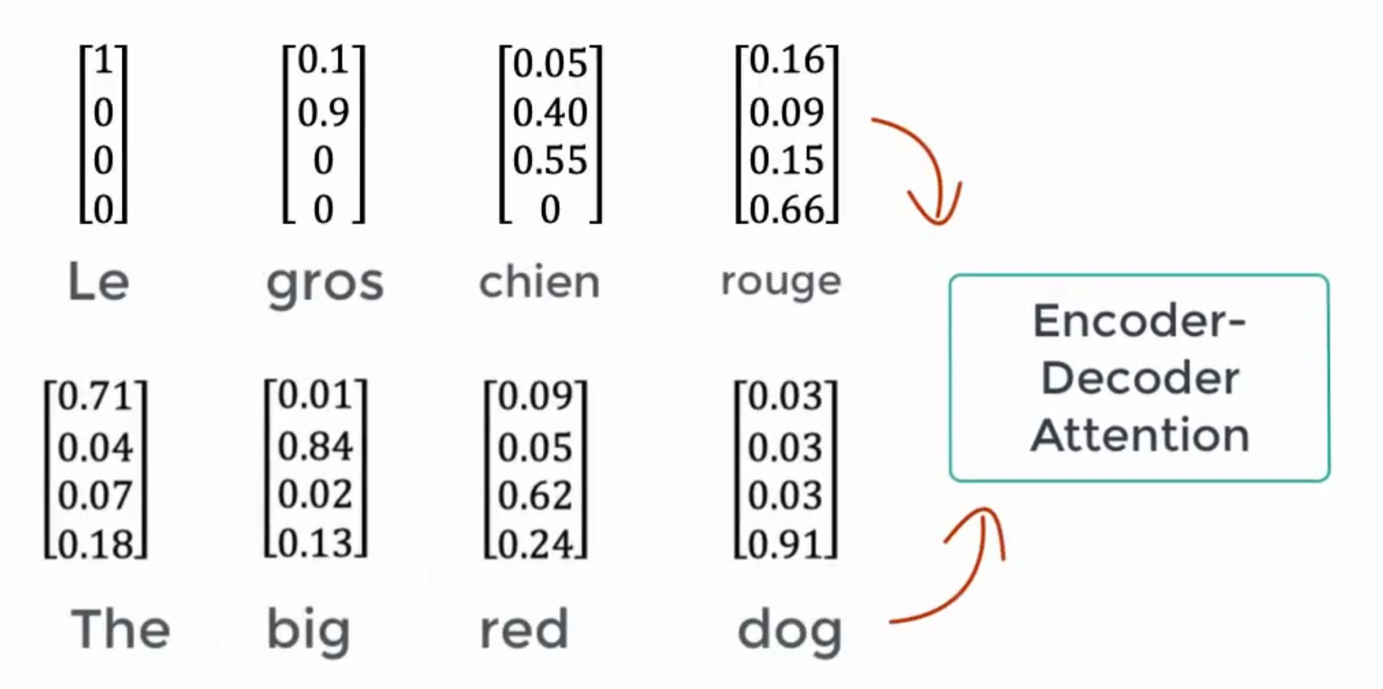
TRANSFORMERS ARCHITECTURE
3
29
First The input sequence can be passed in parallel …
Second is Encoder Block
Third is Decoder Block :
🠺
🠺
Embedding Vectors
Masked Multi-head attention
Multi-head attention (for Decoder & Encoder)

Slide 32
TRANSFORMERS ARCHITECTURE
3
30
First The input sequence can be passed in parallel …
Second is Encoder Block
Third is Decoder Block :
🠺
🠺
Embedding Vectors
Masked Multi-head attention (Each vector represents the relationship with other words in both languages )
Feed-Forward Networks
Le
gros
chien
rouge

Slide 33
TRANSFORMERS ARCHITECTURE
3
31
First The input sequence can be passed in parallel …
Second is Encoder Block
Third is Decoder Block :
🠺
🠺
Embedding Vectors
Masked Multi-head attention (Each vector represents the relationship with other words in both languages )
Feed-Forward Networks (it will make the output vectors into a form that is easily acceptable by another decoder block or a linear layer. )
Le
gros
chien
rouge

Slide 34
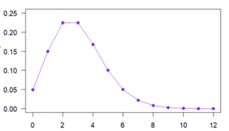
TRANSFORMERS ARCHITECTURE
3
32
First The input sequence can be passed in parallel …
Second is Encoder Block
Third is Decoder Block :
Fourth is Feed-Forward Linear (expands the dimensions into numbers of words in the French language after translation)
Fifth is SoftMax (transforms the input into a probability distribution) then the resulting word is produced with the highest probability after translation.
🠺
🠺
Final Output
Le
gros
chien
rouge

Slide 35
TRANSFORMERS ARCHITECTURE
3
33
Encoder
🠺
The
Big
Red
Dog
🠺
Final Output
Le
gros
chien
rouge
Decoder

Slide 36
4
34
🠺
TRANSFORMERS IDEA
RESULTS AND DISCUSSION
01
03
02
04
INTRODUCTION
TRANSFORMERS
ARCHITECTURE

Slide 37
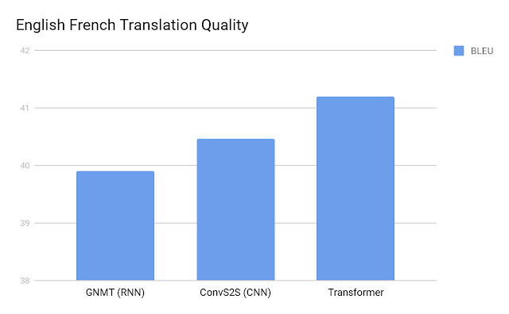
SIMULATION RESULTS AND DISCUSSION
4
35
🠺
🠺

Slide 38
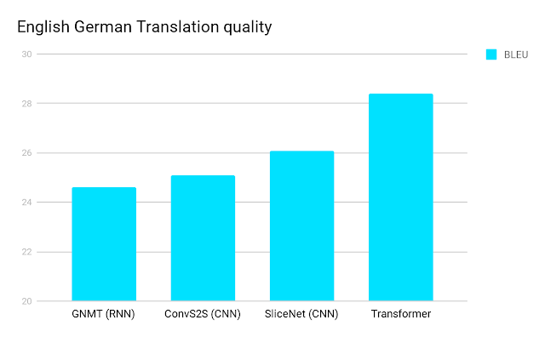
SIMULATION RESULTS AND DISCUSSION
4
36
🠺
🠺

Slide 39
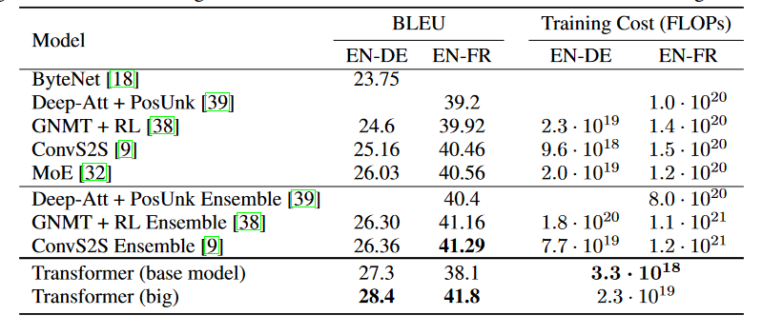
SIMULATION RESULTS AND DISCUSSION
4
37
🠺
🠺

Slide 40
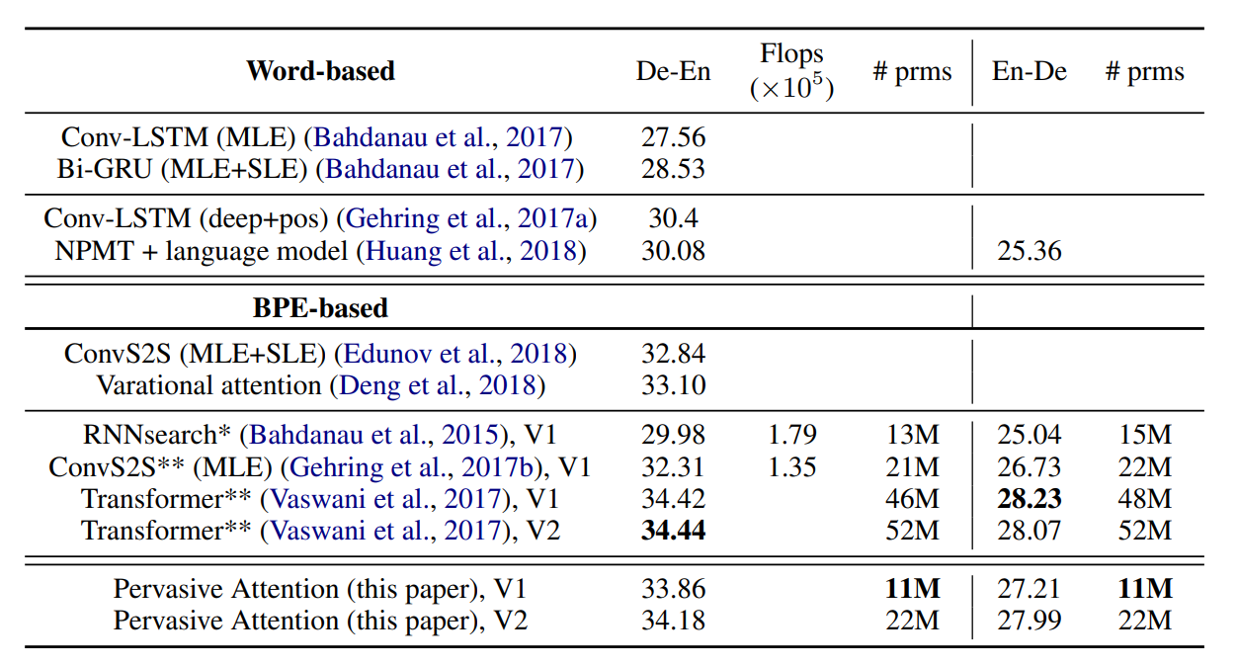

SIMULATION RESULTS AND DISCUSSION
4
38
🠺
Pervasive Attention (2018)
🠺
Paper :

Slide 41
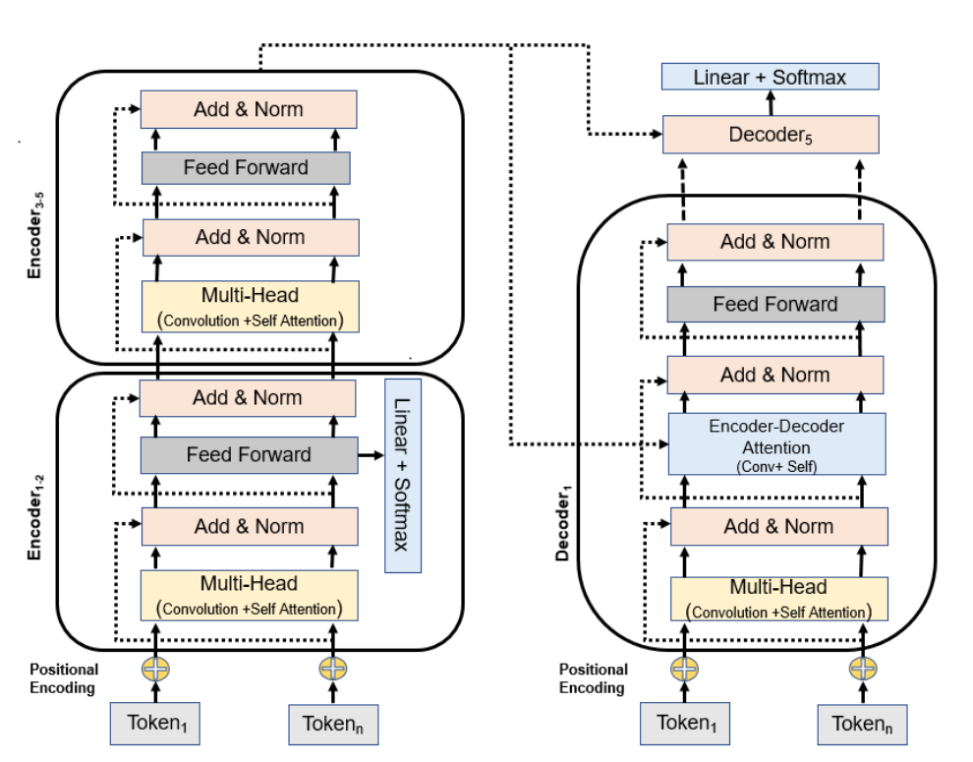
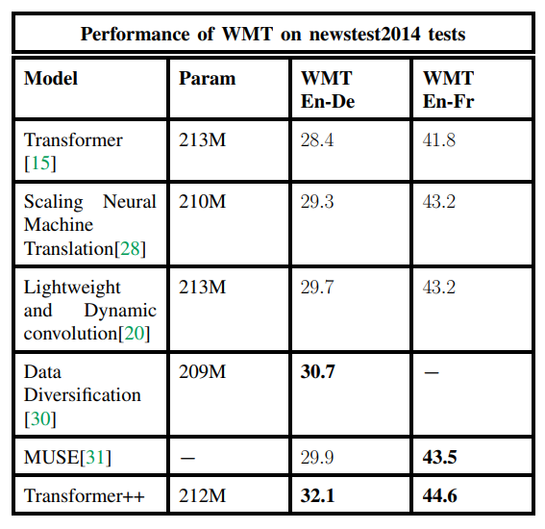

SIMULATION RESULTS AND DISCUSSION
4
39
🠺
Transformer++
(2020)
🠺
Paper :

Slide 42

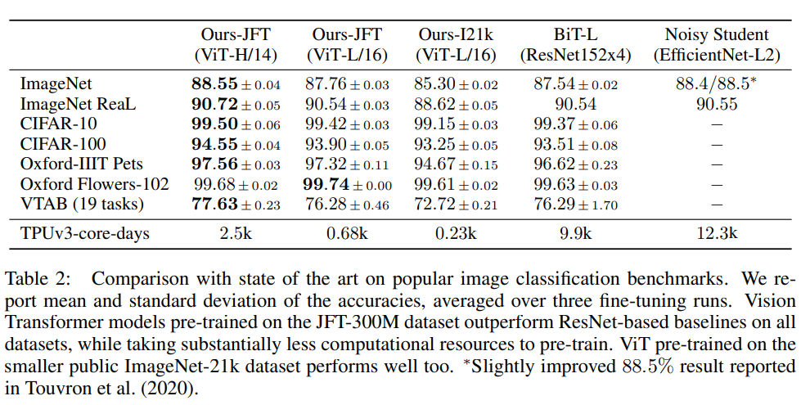
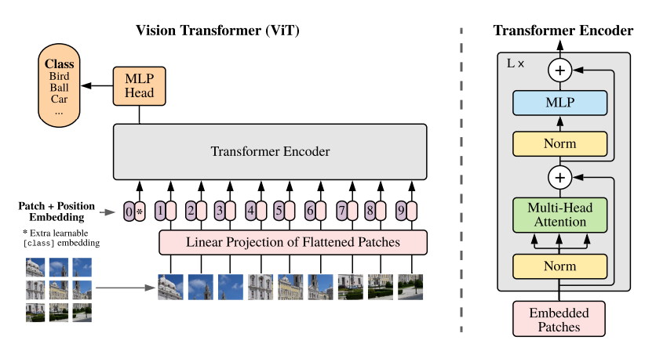
SIMULATION RESULTS AND DISCUSSION
4
40
AN IMAGE IS WORTH 16X16 WORDS:
TRANSFORMERS FOR IMAGE RECOGNITION AT SCALE (2021)
Vision Transformer (ViT)
🠺
🠺
Paper :

Slide 43
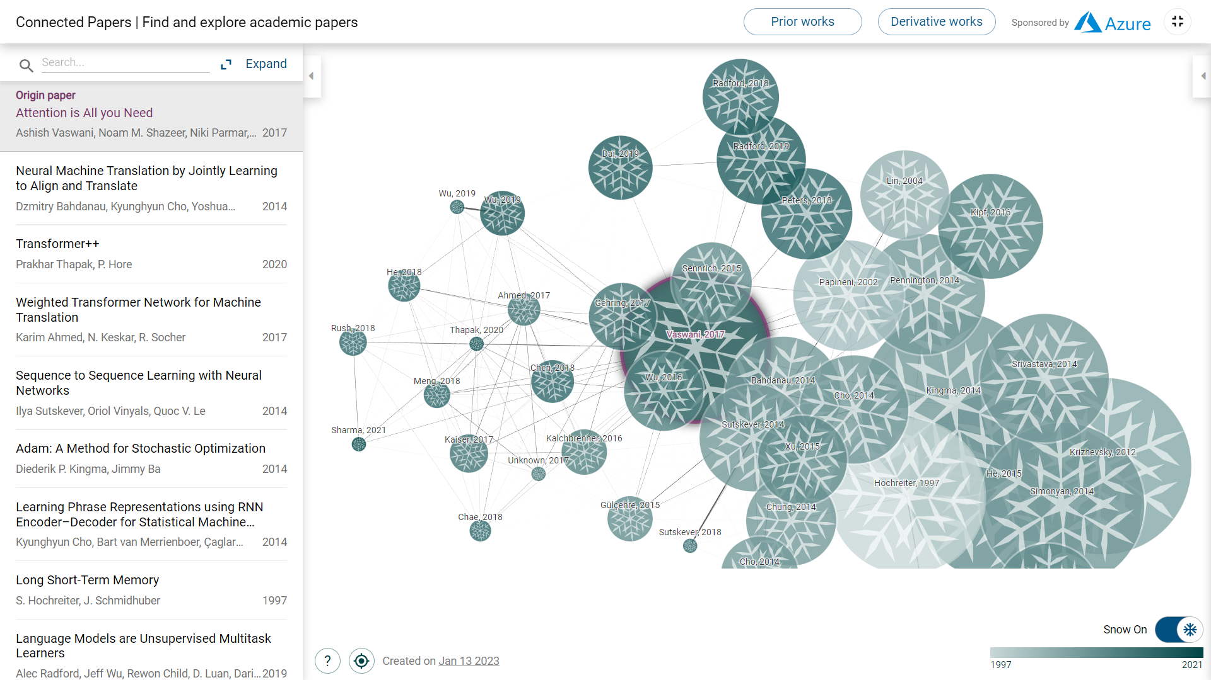
SIMULATION RESULTS AND DISCUSSION
4
40
🠺
🠺

Slide 44

Thank you
4
41
🠺
🠺
Thank you

